Slide 1
The Hill
Telephony Statistics
Prepared April 2024

Slide 2
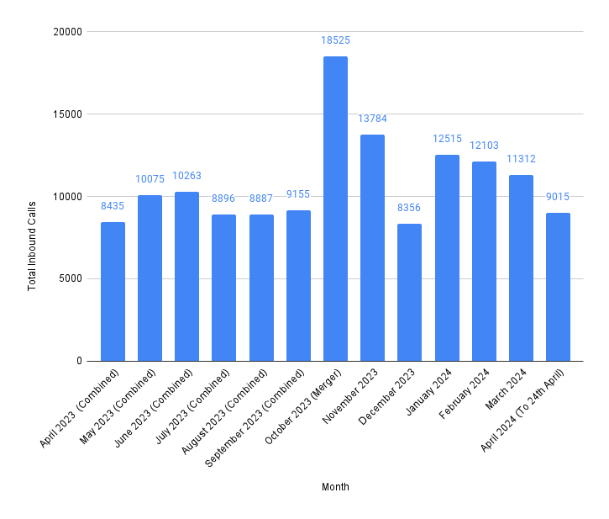
Total Inbound Call Volume
Figures for April-September 2023 are combined from historic statistics for Beaconsfield Road and Harold Road surgeries.
Initially post-merger in October 2023, The Hill’s volume of inbound calls more than doubled, with levels of very high demand continuing throughout winter and into 2024.

Slide 3
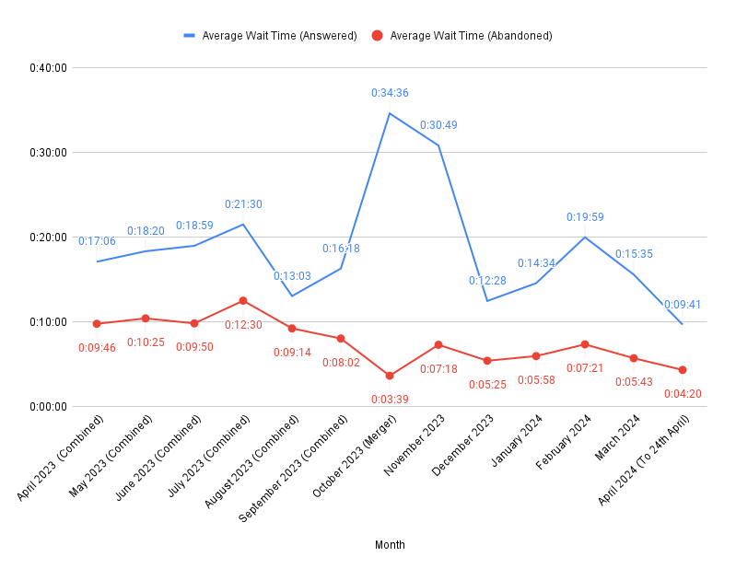
Average Caller Wait Times
The increase in demand post-merger consequently lead to an increase in the average wait before calls were answered.
A drop ‘caller patience’ (ie how long, on average, callers were willing to wait to speak to a receptionist before abandoning their call) also occurred; this was heavily driven by patients abandoning their calls after being told their place in the queue, as the surgery saw upwards of 100 concurrent calls during peak times.

Slide 4
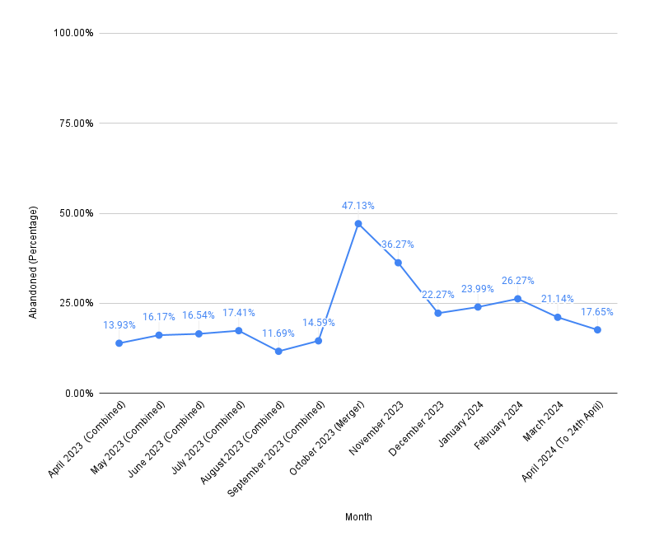
Abandoned Calls
Due to the increase in demand and consequential increase in average wait times, the proportion of patients abandoning their call before being connected to a receptionist has also risen.
Whilst still higher than the levels seen before the merger, this has decreased month-on-month.

Slide 5
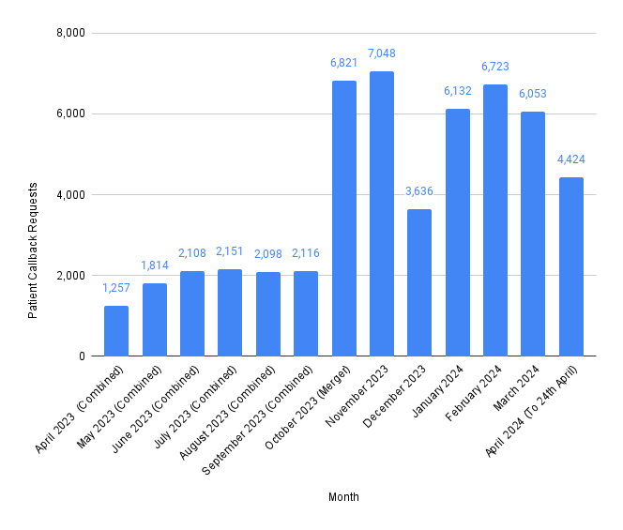
Callbacks
Since the merger, patients are increasingly using our ‘callback’ feature, which enables callers to choose to hold their place in the queue and have a receptionist automatically call them back once they reach the front of the queue, rather than waiting on the line for a receptionist to become available.
Post-merger, an average of 48% of calls each month result in a callback being requested, compared to 20% of calls pre-merger, and patient feedback on this feature is very positive.

Slide 6
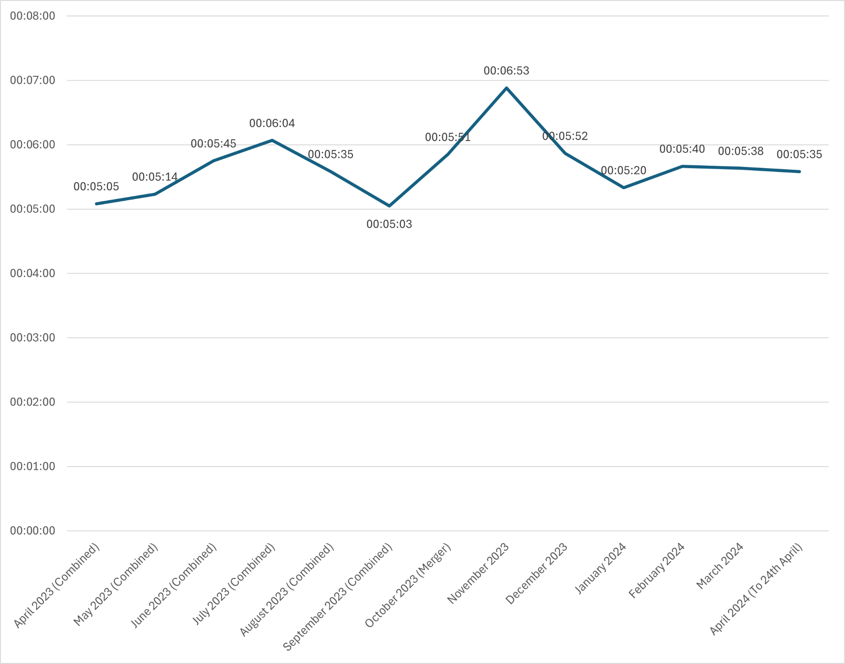
Average Handling Time
Post-merger, the scope of receptionist activities has increased to enable better patient care. Receptionists are now able to directly book appointments with the appropriate clinician and acquire more clinical information from patients to avoid unnecessary follow-up calls from the practice.
As a result of training and support, this more involved approach has not lead to a significant increase in the average handling time of calls.

Slide 7
Patient Satisfaction Survey
Since July 2023, a proportion of callers are automatically presented with a post-call survey, asking them to score three questions from 1-10, with 1 being the lowest and 10 the highest. This enables us to gauge satisfaction with three metrics - the service provided by the receptionist, the patient’s satisfaction with the wait time, and whether the patient’s query was resolved.
Patient satisfaction ratings dropped in October, following the merger, but have subsequently climbed to their previous levels of high satisfaction.

Slide 8
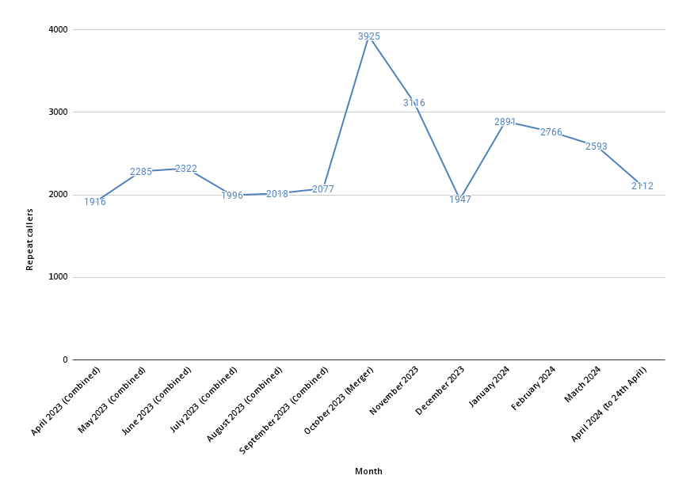
Repeat Callers
The number of calls driven by patients calling in more than once saw an increase post-merger, dropping over winter before spiking once again in January.
Due to the increased awareness of our callback option and our focus on being able to resolve queries at the patient’s ‘first point of contact’, these repeat calls are progressively lowering towards pre-merger levels.

